Slide 1
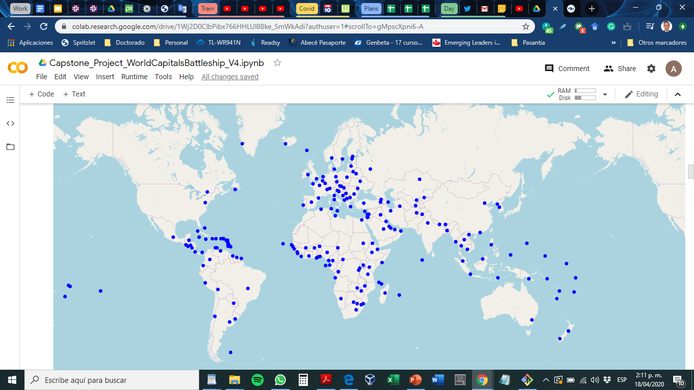

Slide 2
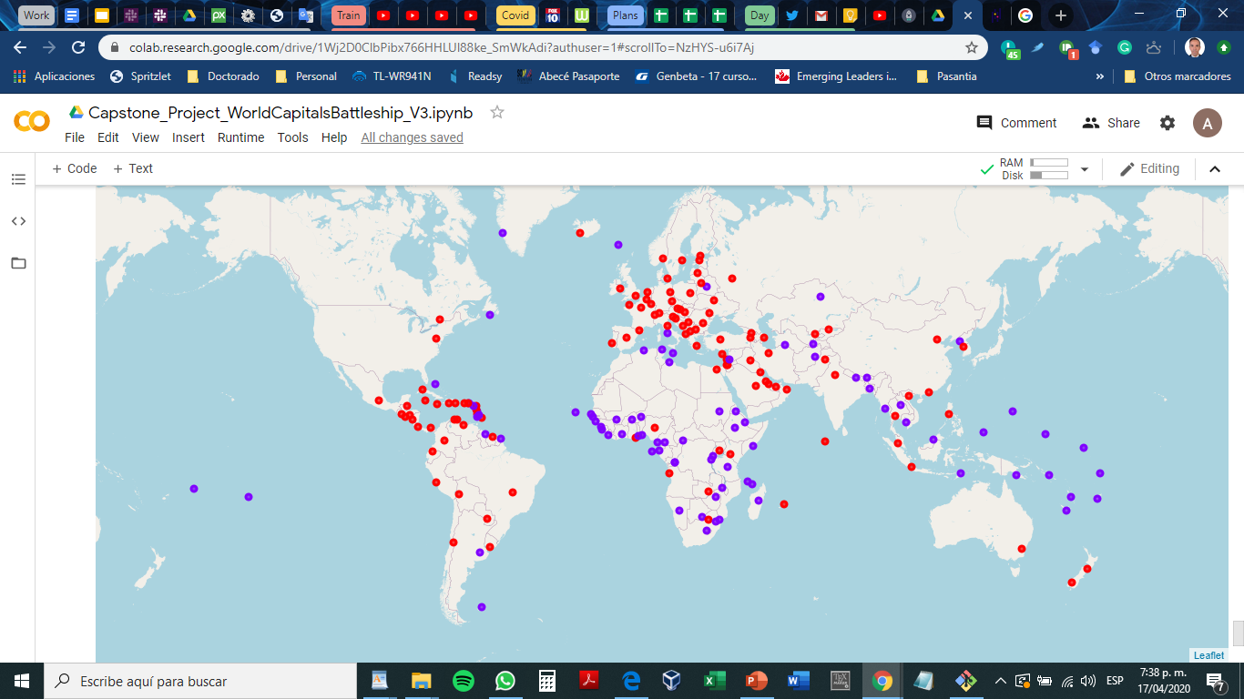
Notes:
K=2

Slide 3
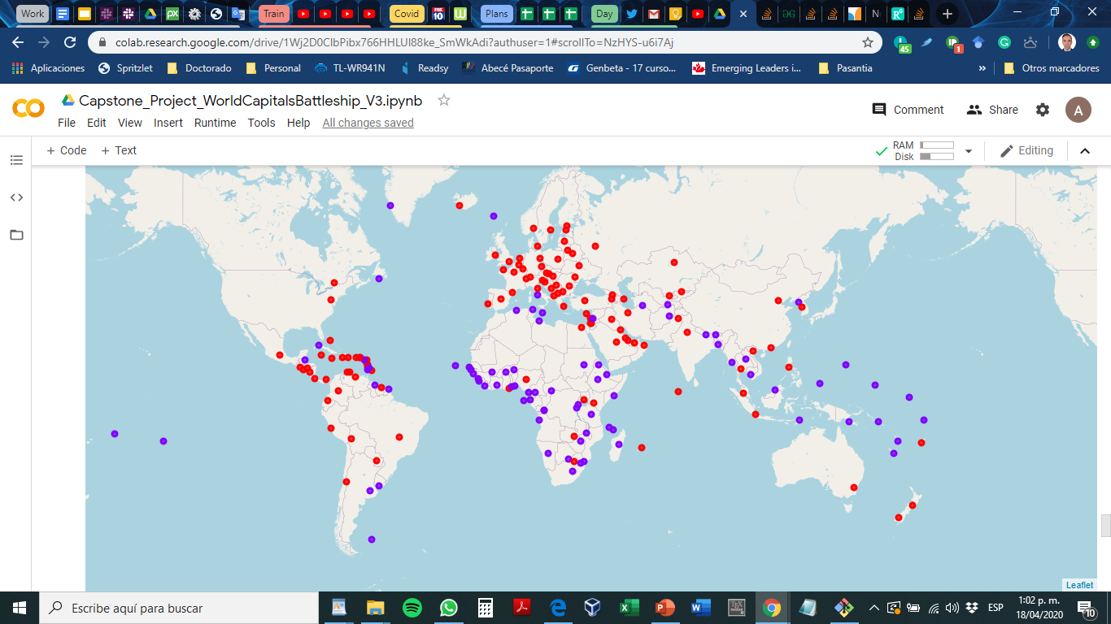
K=2, preprocessed
Notes:
K=2, Pre processed

Slide 4
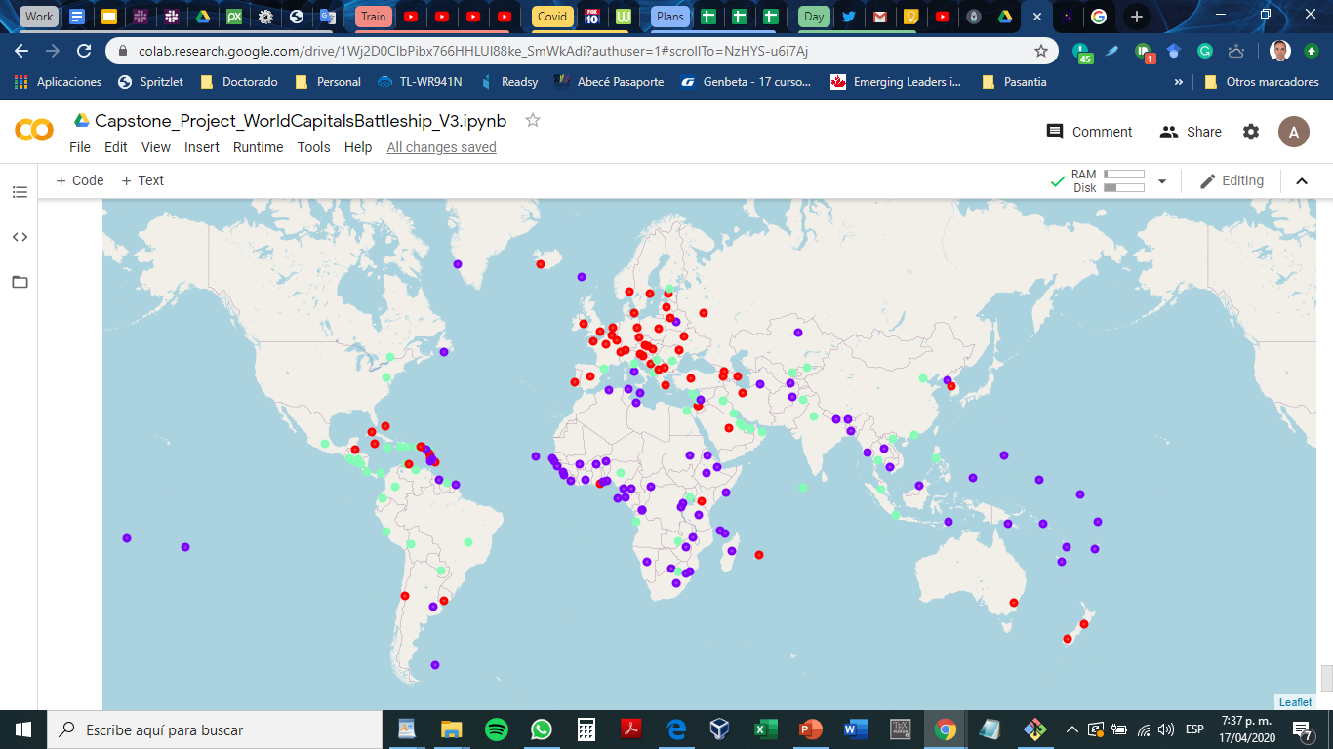
Notes:
K=3

Slide 5
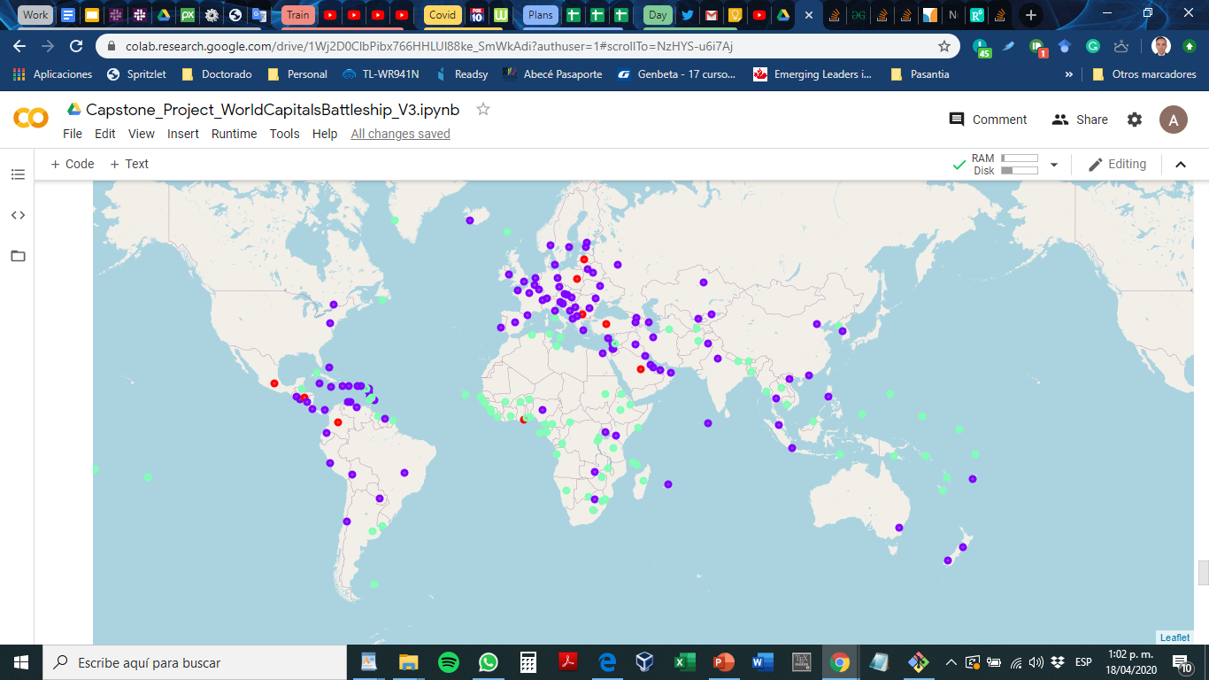
K=3, preprocessed
Notes:
K=3 , Pre processed

Slide 6
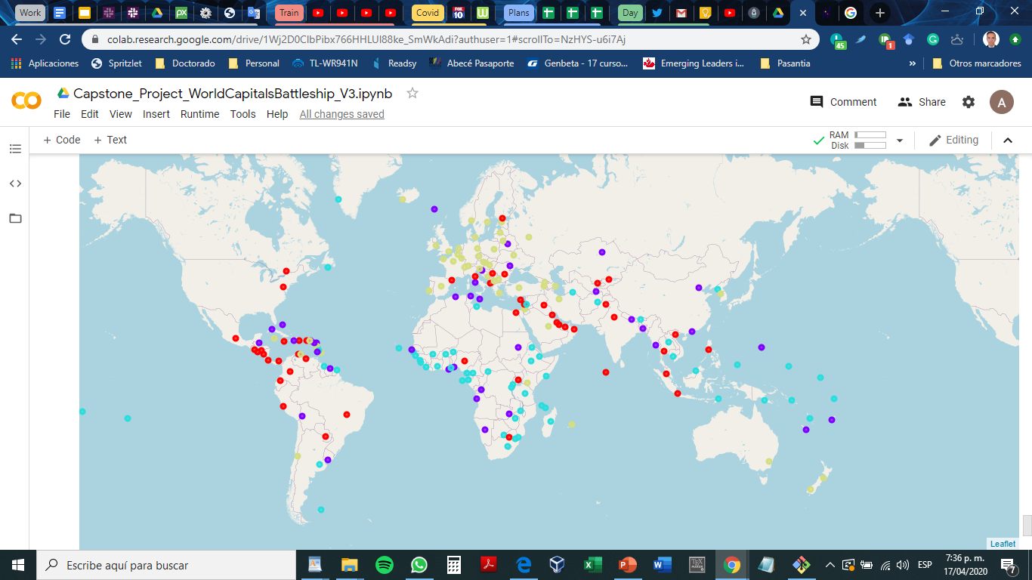
Notes:
=4

Slide 7
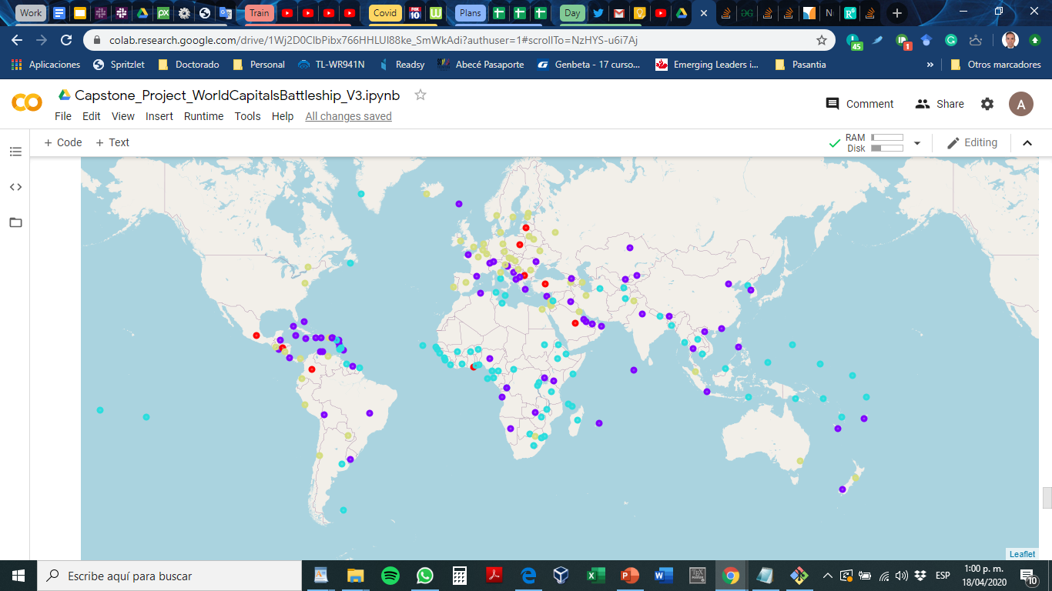
K=4, preprocessed
Notes:
K= 4 Pre processed

Slide 8
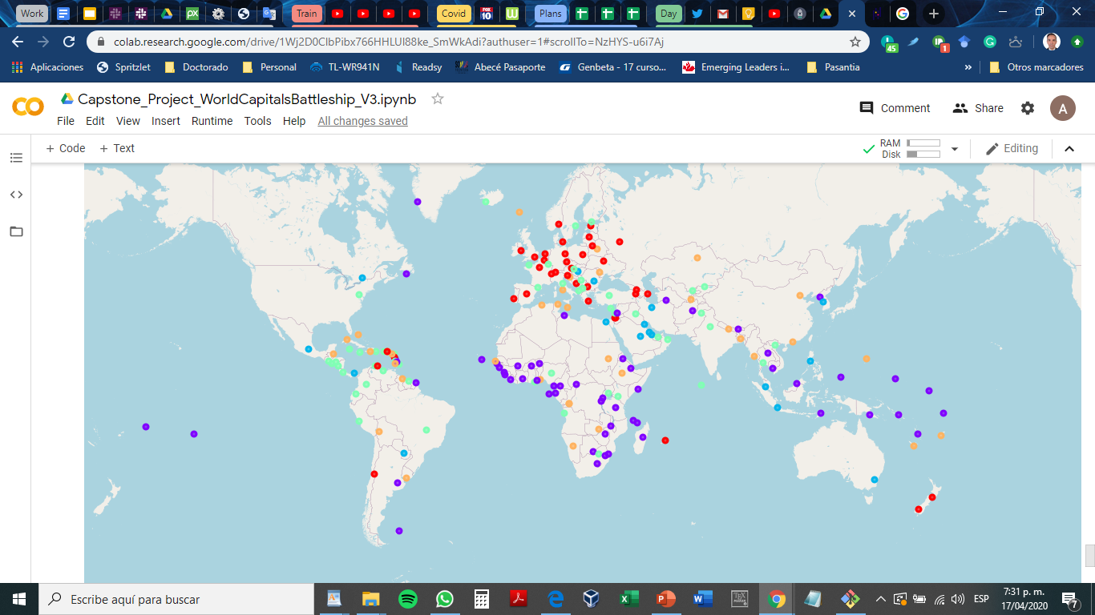
Notes:
K=5

Slide 9

K=5, preprocessed
Notes:
K=5, preprocessed

Slide 10
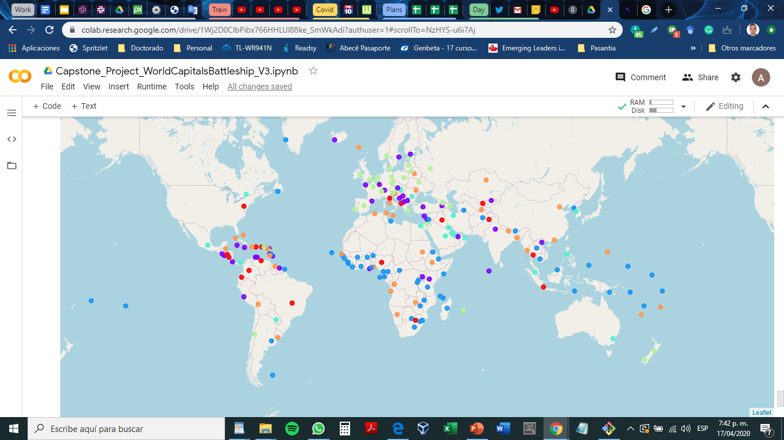
Notes:
K=6

Slide 11
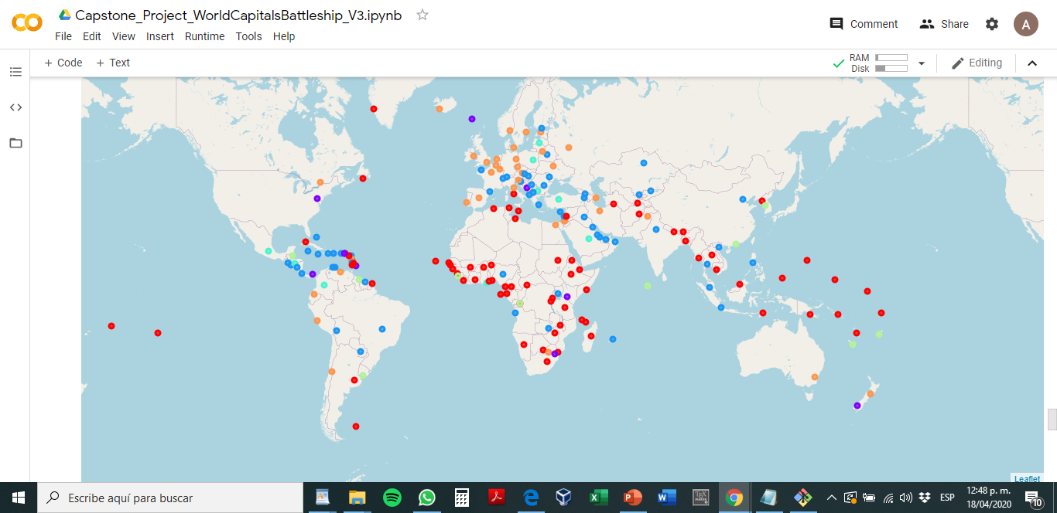
K=6, preprocessed
Notes:
K=6, preprocessed

Slide 12
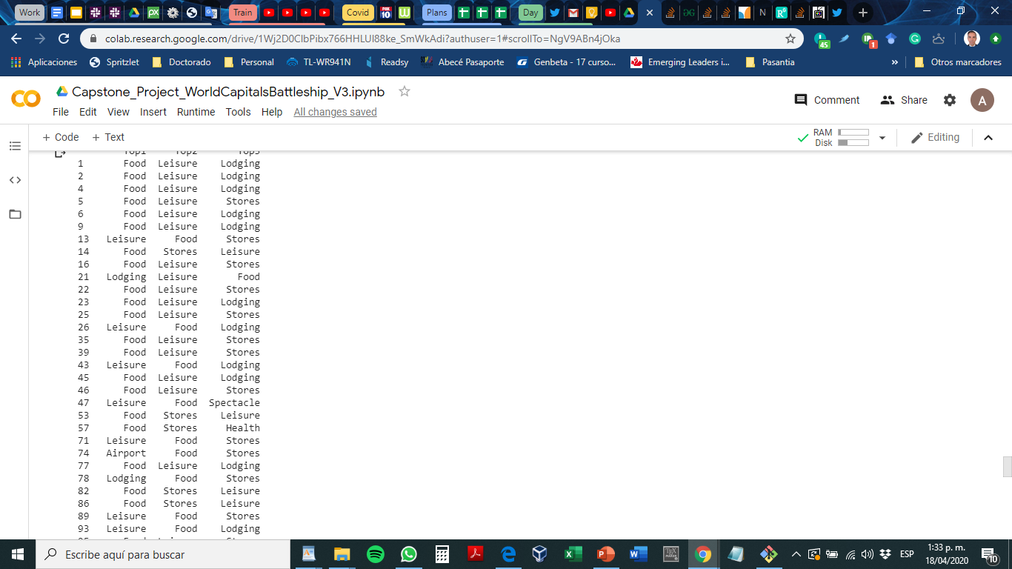


Slide 13
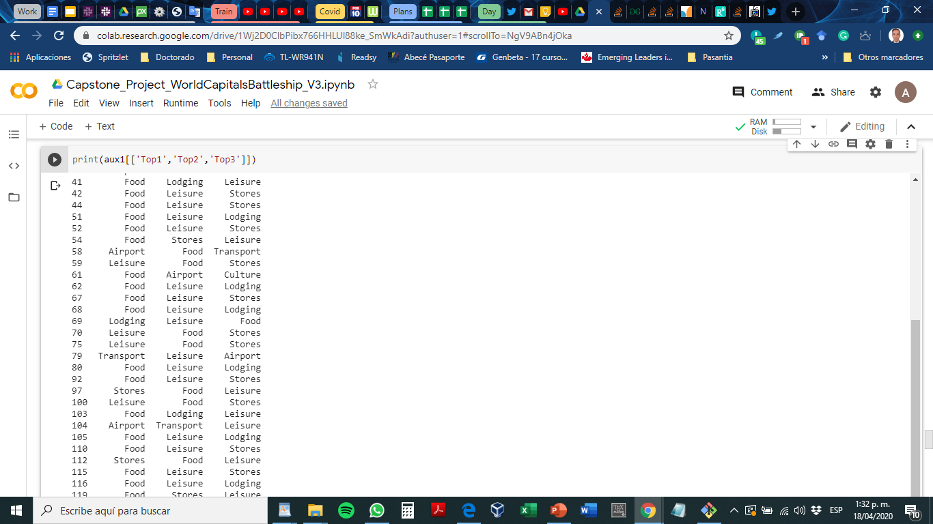
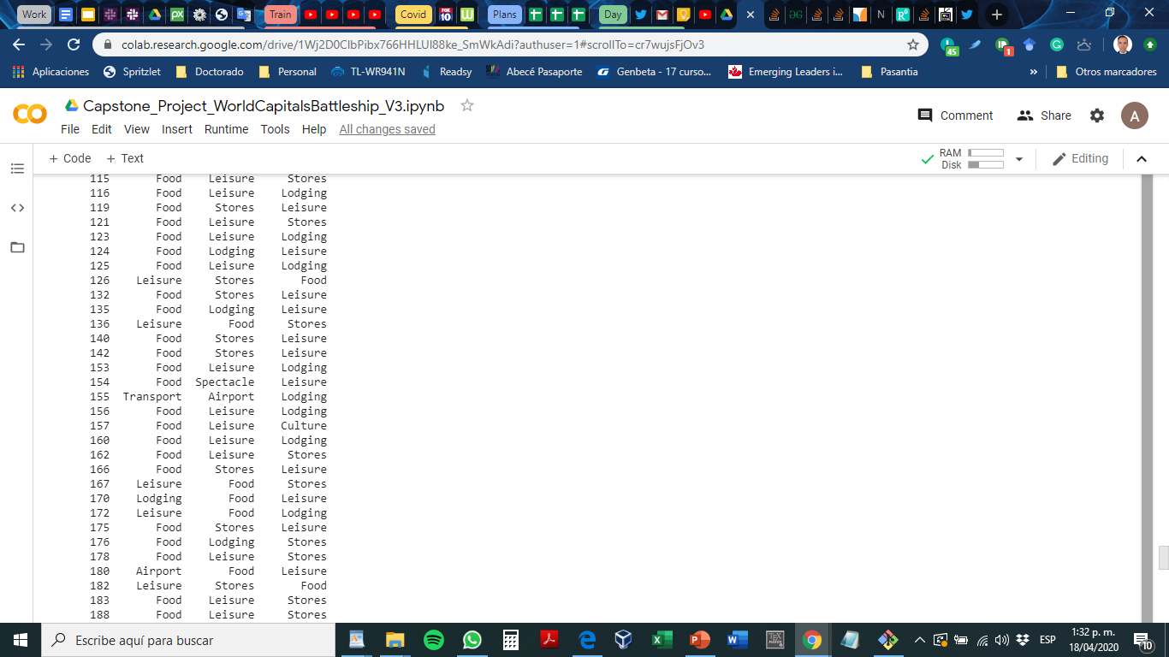
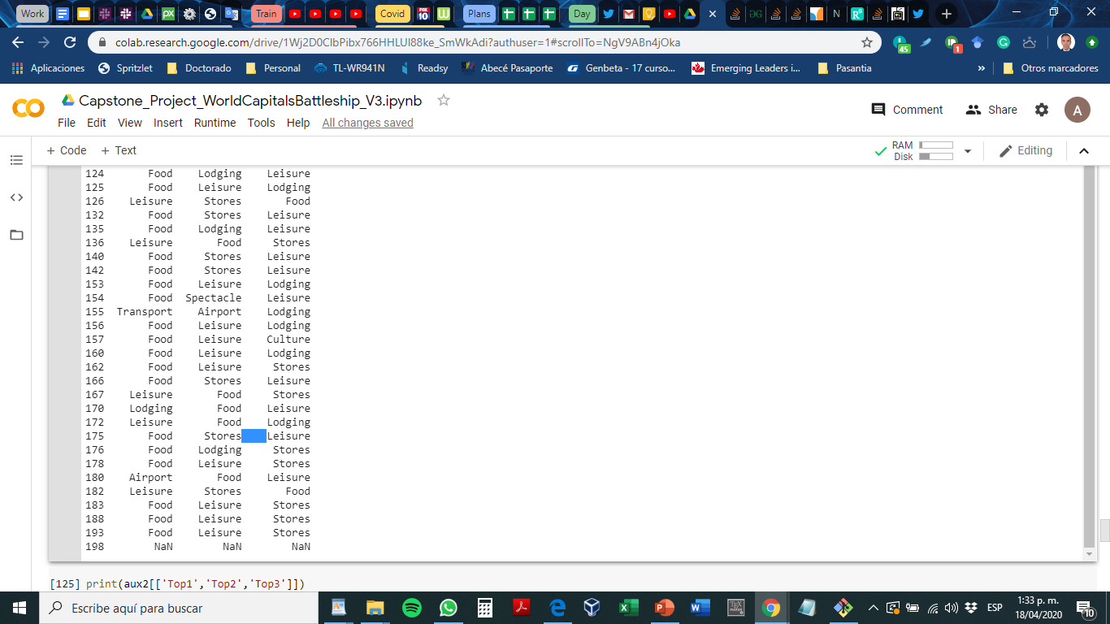

Slide 14
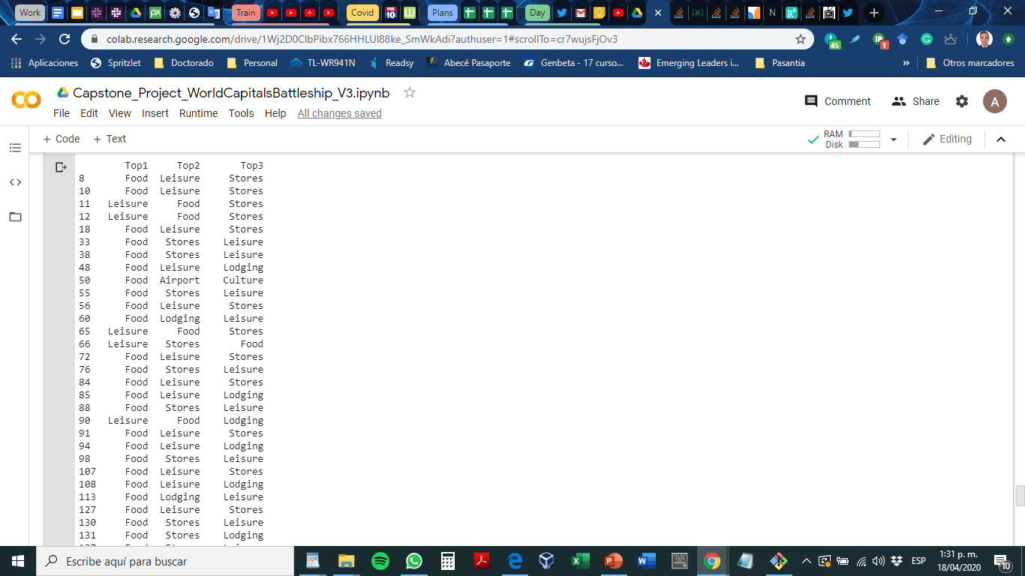
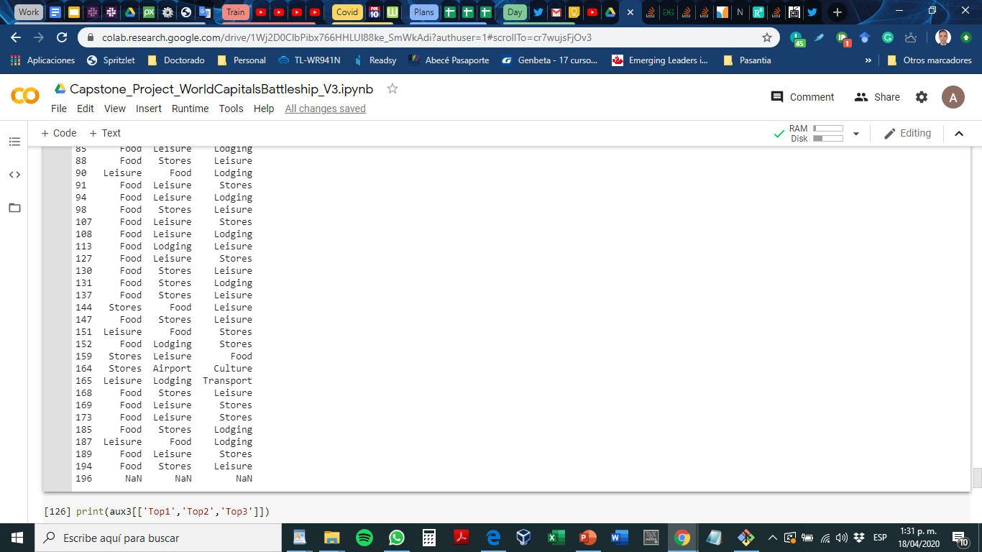

Slide 15


Slide 16


Slide 17
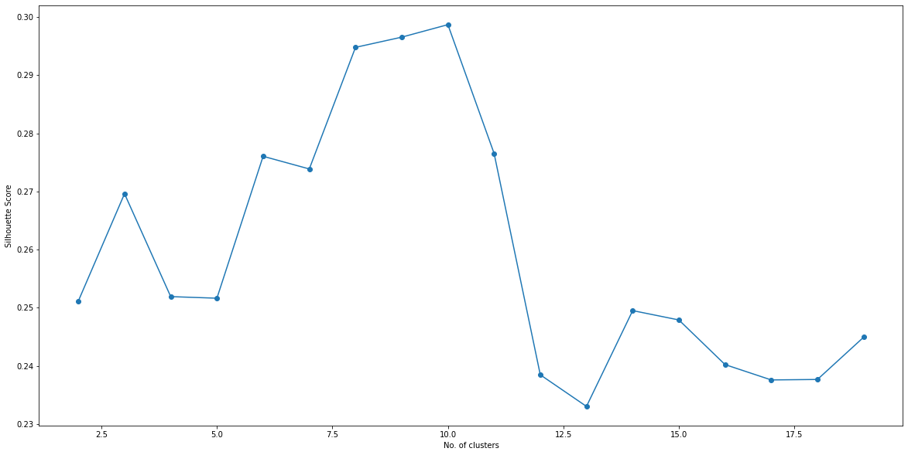

Slide 18
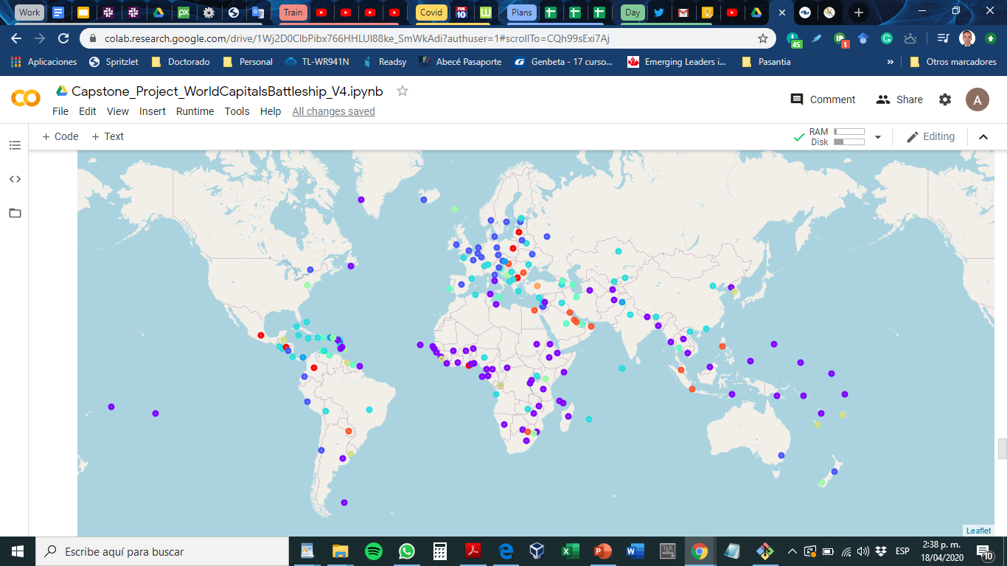
Notes:
K=10

Slide 19
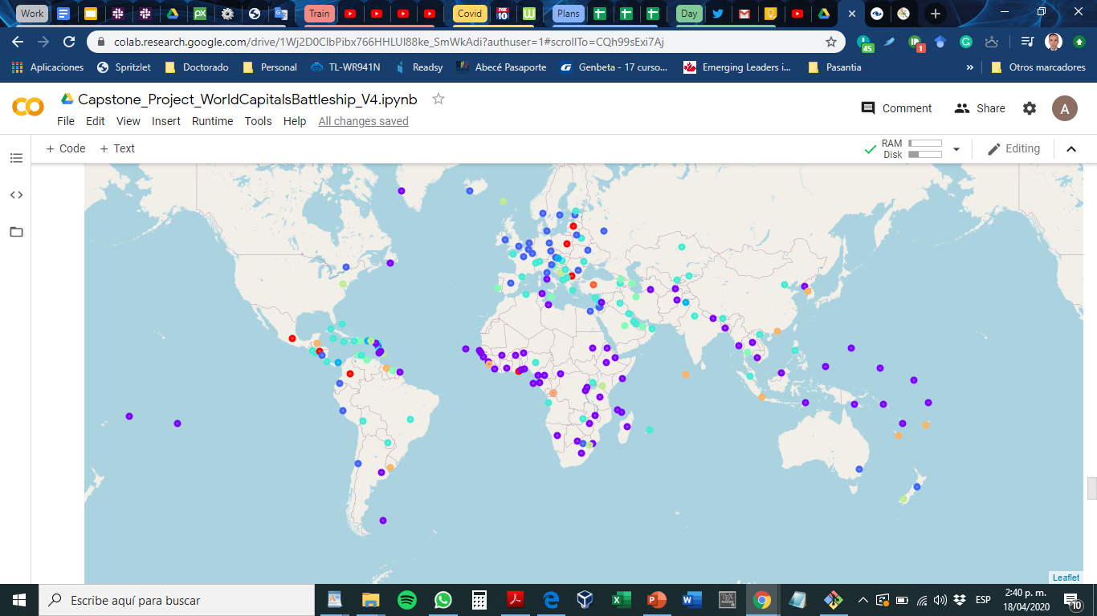
Notes:
K=9

Slide 21
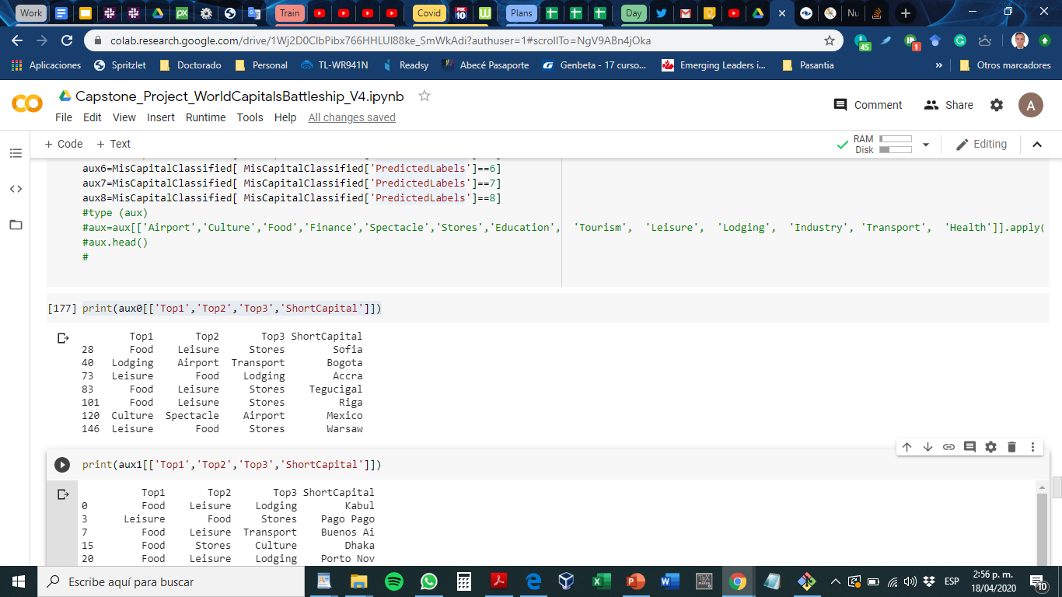

Slide 22
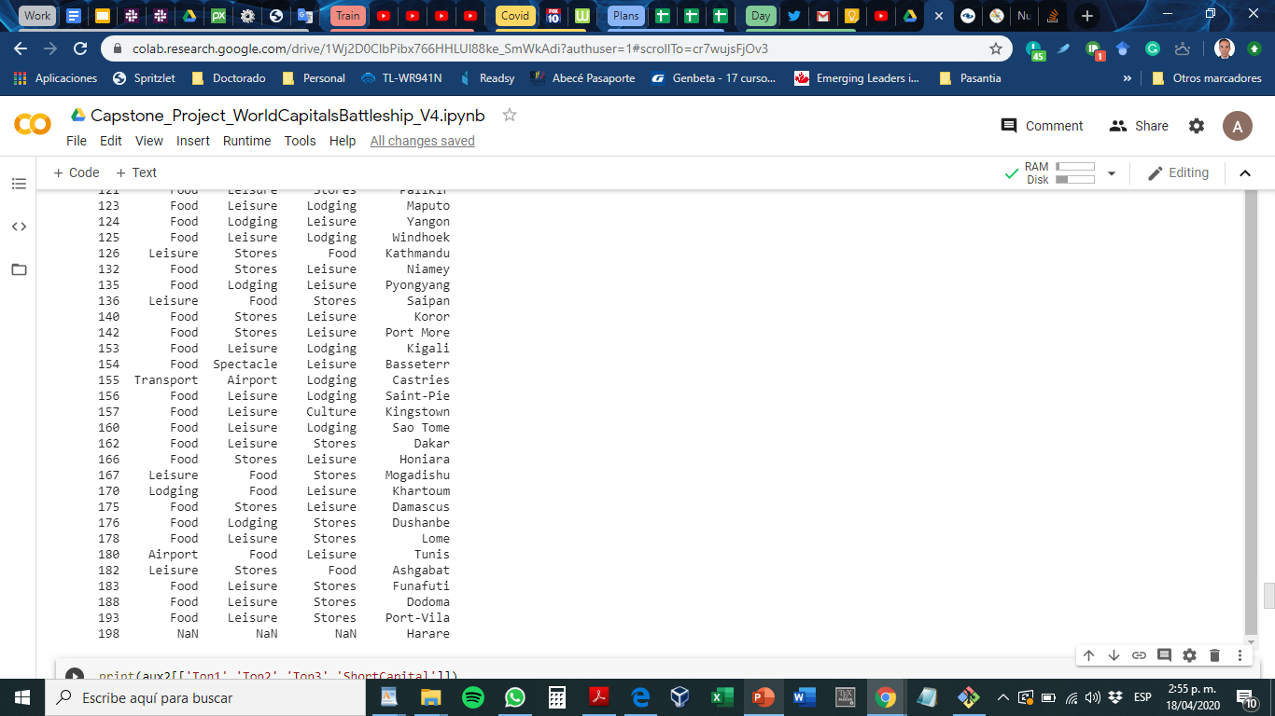
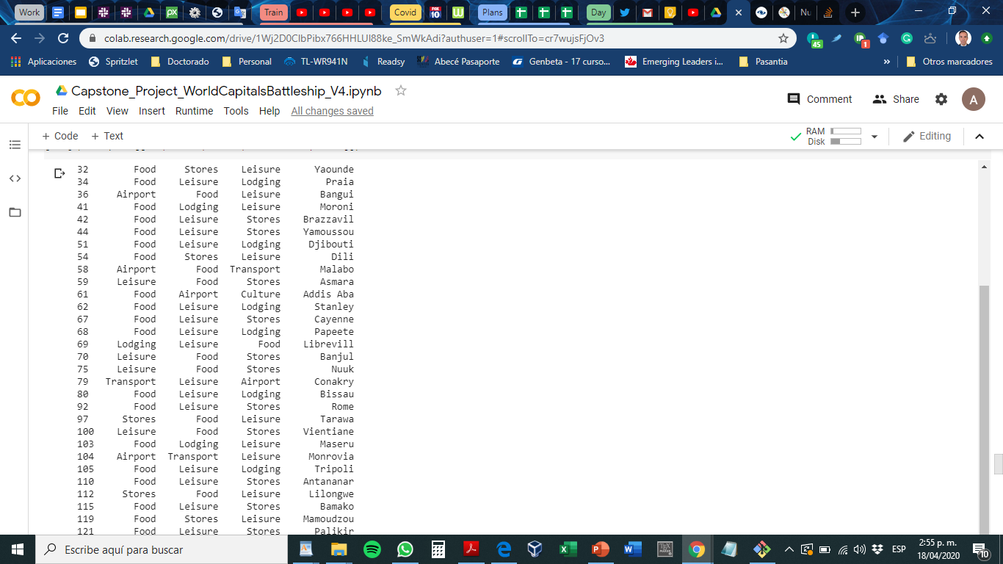
aux1

Slide 23
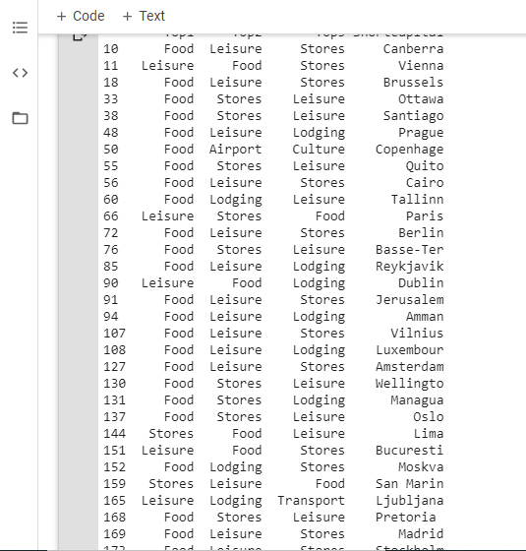
aux2

Slide 24
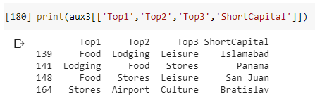

Slide 25

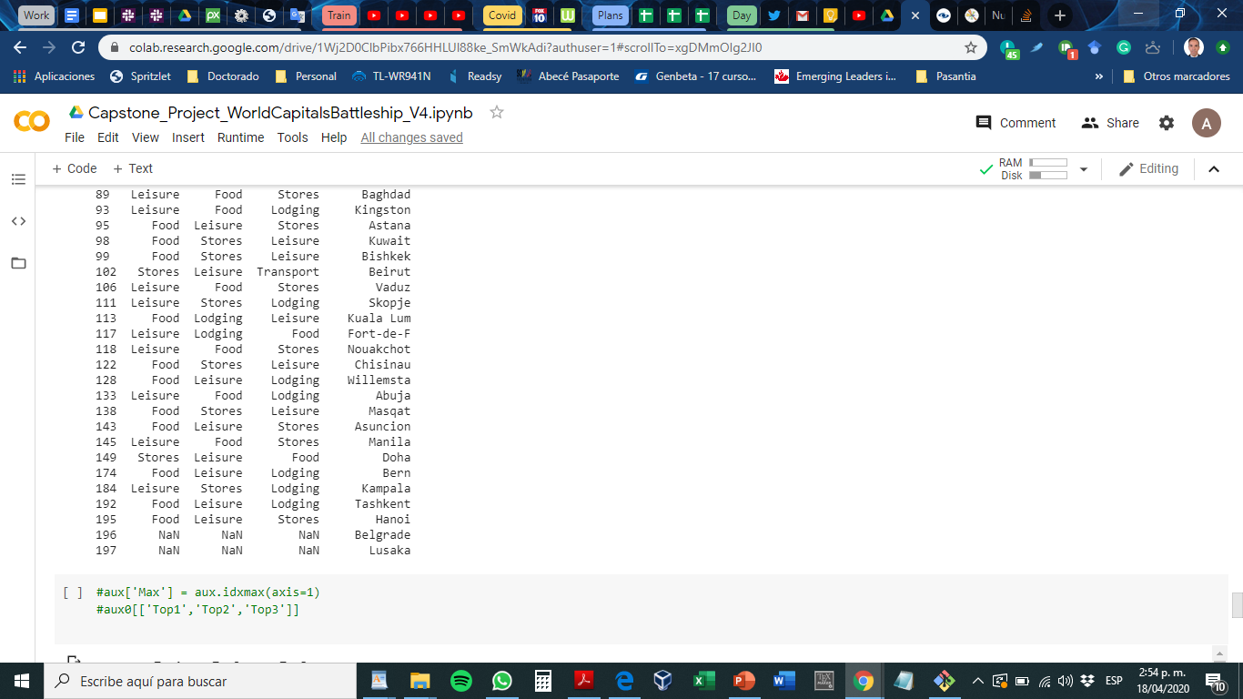
aux4

Slide 26


Slide 28
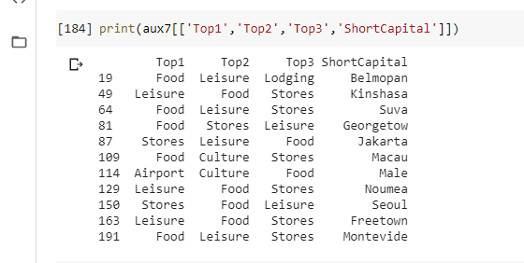

Slide 29
Introduction
Houston, Texas is one of the fastest growing cities in the United States
Oneofthebiggestproblemsfacingthecity is that of food deserts
Individuals living in areas classified as food deserts are shown to have an increased risk of developing diabetes, cardiovascular disease, and being obese
While bad for public health, these fooddesertslocations are relevant to business as they are areas that are under served or lack competition
Good for business owners looking to build a new grocery store.

Slide 30
Business Problem
Find what areas could be considered food deserts
Usethisdatatofurther answerthequestion what would be the best area for a business owner or property developer to open a new grocery store that it has the least competition leading to a higher possibility of a successful store.

Slide 31
Interested Parties
Public Health officials
PeoplelookingtomovetoHoustonandwantingtoliveinasuperneighborhood with easy access to grocery stores
Business owners and project developers looking to build a new grocery store that has the least competition possibly leading to a more successful store.

Slide 32
Data
Data RequiredListofSuperNeighborhoodsinHouston
Coordinatesofsuperneighborhoods
FrequencyofGroceryStoresineachNeighborhood
Source of Data•Wikipediapage showing Houston Super Neighborhoods•https://en.m.wikipedia.org/wiki/List_of_Houston_neighborhoods
•Geocoder for coordinates
•FoursquareAPI for grocery store data

Slide 33
Methodology
Web scrape Wikipedia page for list of super neighborhoods in Houston, Texas
Use geocodertogetlatitudeandlongitude coordinatesofneighborhoods
Check neighborhood locations for accuracy
Use Foursquare API to find frequency of grocery stores within each neighborhood
Clusterdatausing k-meansclustering and visualize data using Folium
Further analyze the best cluster to open a new grocery store

Slide 34
Results
Neighborhoods were clustered into one of 4 groupsCluster 0: Neighborhoods with moderate frequency of grocery stores
Cluster1: Neighborhoods with high frequency of grocery stores
Cluster 2: Neighborhoods with low frequency of grocery stores
Cluster 3: Neighborhoods with very high frequency of grocery stores

Slide 35
More results tables or graphics

Slide 36
Discussion/Conclusion
Houston overall has a low frequency of grocery stores within its super neighborhoods, having a mean frequency of grocery stores being 0.24497. For clusters, cluster 2hastheloweroverall frequency of grocery stores by comparison to other clusters. With cluster 3 having the highest frequency of grocery stores by comparison making it a possible outlier cluster super neighborhood in Houston Texas.
In terms ofthebestlocationtosetupanewgrocerystore, cluster 2 would be the best due to the low frequency and competition present, and the bestoveralllocation would be either Central Houston or areas within the loop. The worst

